Slide 2
¹⁵ Pay careful attention, then, to how you walk—not as unwise people but as wise—¹⁶ making the most of the time, because the days are evil. ¹⁷ So don’t be foolish, but understand what the Lord’s will is.
Notes:
15 Pay careful attention, then, to how you walk—not as unwise people but as wise—16 making the most of the time,^{A,e} because the days are evil. 17 So don’t be foolish, but understand^{f} what the Lord’s will^{g} is. Literally buying back the time

Slide 3
Relationships
Wives <-> Husbands
Husbands <-> Wives
Children <-> Parents
Parents <-> Children
Slaves <-> Masters
Masters <-> Slaves

Slide 4
Relationships
New Christian <-> The World

Slide 5
¹⁸ And don’t get drunk with wine, which leads to reckless living, but be filled by the Spirit: ¹⁹ speaking to one another in psalms, hymns, and spiritual songs, singing and making music with your heart to the Lord, ²⁰ giving thanks always for everything to God the Father in the name of our Lord Jesus Christ, ²¹ submitting to one another in the fear of Christ.

Slide 6
Things to Know
Paul believes the time is fleeting.
Paul is building a foundation for the churches
Paul preaches the liberating freedom of the Christian.
Paul’s message is radical - whoever you are whatever your position you have equal value to your Christian neighbor:
“There is no Jew or Greek, slave or free, male and female; since you are all one in Christ Jesus.” ^{Gal 2:28}

Slide 7
Wives <-> Husbands
²² Wives, submit to your husbands as to the Lord, ²³ because the husband is the head of the wife as Christ is the head of the church. He is the Savior of the body. ²⁴ Now as the church submits to Christ, so also wives are to submit to their husbands in everything.

Slide 8
Husbands <-> Wives
²⁵ Husbands, love your wives, just as Christ loved the church and gave himself for her ²⁶ to make her holy, cleansing her with the washing of water by the word. ²⁷ He did this to present the church to himself in splendor, without spot or wrinkle or anything like that, but holy and blameless.

Slide 9
Husbands <-> Wives
²⁸ In the same way, husbands are to love their wives as their own bodies. He who loves his wife loves himself. ²⁹ For no one ever hates his own flesh but provides and cares for it, just as Christ does for the church, ³⁰ since we are members of his body.

Slide 10
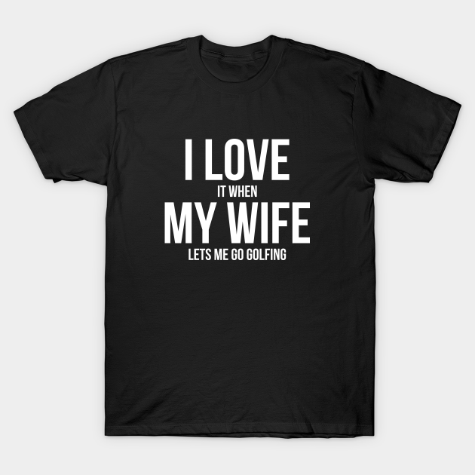
Options Include: I love it when my wife lets me go drag racing I love it when my wife lets me watch football I love it when my wife lets me play rugby I love it when my wife lets me play golf I love it when my wife lets me go camping I love it when my wife lets me play basketball I love it when my wife lets me go swimming I love it when my wife lets me play tennis I love it when my wife lets me go hiking I love it when my wife lets me buy car parts I love it when my wife lets me go scuba diving I love it when my wife lets me buy more guns I love it when my wife lets me buy another bike I love it when my wife lets me play video games I love it when my wife lets me go fishing I love it when my wife lets me ride my motorcycle I love it when my wife leaves me alone I love it when my wife lets me go sailing I love it when my wife lets me go bowling I love it when my wife lets me go skiing I love it when my wife lets me ride my dirt bike [..]

Slide 11
Husbands <-> Wives
³¹ For this reason a man will leave his father and mother and be joined to his wife, and the two will become one flesh. ³² This mystery is profound, but I am talking about Christ and the church. ³³ To sum up, each one of you is to love his wife as himself, and the wife is to respect her husband.

Slide 12
Children <-> Parents Parents <-> Children
^{6:1} Children, obey your parents in the Lord, because this is right. ² Honor your father and mother, which is the first commandment with a promise, ³ so that it may go well with you and that you may have a long life in the land. 4 Fathers, don’t stir up anger in your children, but bring them up in the training and instruction of the Lord.

Slide 13
Slaves <-> Masters Masters <-> Slaves
⁵ Slaves, obey your human masters with fear and trembling, in the sincerity of your heart, as you would Christ. ⁶ Don’t work only while being watched, as people-pleasers, but as slaves of Christ, do God’s will from your heart. ⁷ Serve with a good attitude, as to the Lord and not to people, ⁸ knowing that whatever good each one does, slave or free, he will receive this back from the Lord. ⁹ And masters, treat your slaves the same way, without threatening them, because you know that both their Master and yours is in heaven, and there is no favoritism with him.

