Slide 1
STAND IN PRAYER
Ephesians 6:18-20
Notes:
John Bunyan, The Pilgrim’s Progress This is when Christian is in the Valley of the Shadow of Death. He had just fought against the adversary name Apollyon in the Valley of Humiliation, but Christian comes to another valley, the Valley of the Shadow of Death, and as he’s walking through this valley that’s full of darkness, there’s a ditch on one side, there’s mire on the other, he can’t see clearly; and he finds that the various weapons that he’s been given fail him in this moment.
There’s a moment where it says that Christian is so confounded that he did not know his own voice, and he’s standing right on the brink of this burning pit, and one of the wicked ones comes up behind him and whispers softly in his ear, suggesting grievous blasphemies to him; and Christian thinks that it’s his own mind, it’s his own voice. He is so assaulted by the evil one in this moment.
“About the midst of this valley I perceived the mouth of hell to be, and it stood also hard by the wayside. Now thought Christian, what shall I do? And ever and anon the ﬂame and smoke would come out in such abundance, with sparks and hideous noises (things that cared not for Christian’s sword, as did Apollyon before), that he was forced to put up his sword, and betake himself to another weapon, called “All-Prayer.””

Slide 2
Verse
“scripture”
Notes:
Petra “This Means War” 1987 – John and Dino Elephante.

Slide 3
“Prayer is the ﬁrst thing, the second thing, the third thing necessary to minister. Pray, therefore, my dear brother, pray, pray, pray.” Edward Payson – Author

Slide 4
How to Stand in Prayer (v18)
At All Times

Slide 5
Pray at All Times
1 Thessalonians 5:17:
“Pray constantly”
Acts 1:14:
“They all were continually united in prayer, along with the women, including Mary the mother of Jesus, and his brothers.”
Psalm 139:17-18
¹⁷ God, how precious your thoughts are to me; how vast their sum is! ¹⁸ If I counted them, they would outnumber the grains of sand; when I wake up, I am still with you.

Slide 6
Pray at All Times
“There is a way of ordering our mental life on more than one level at once. On one level we can be thinking, discussing, seeing, calculating, meeting all the demands of external affairs. But deep within, behind the scenes, at a profounder level, we may also be in prayer and adoration, song and worship, and a gentle receptiveness to divine breathings.
Notes:
Thomas R Kelly “A testament of Devotion”

Slide 7
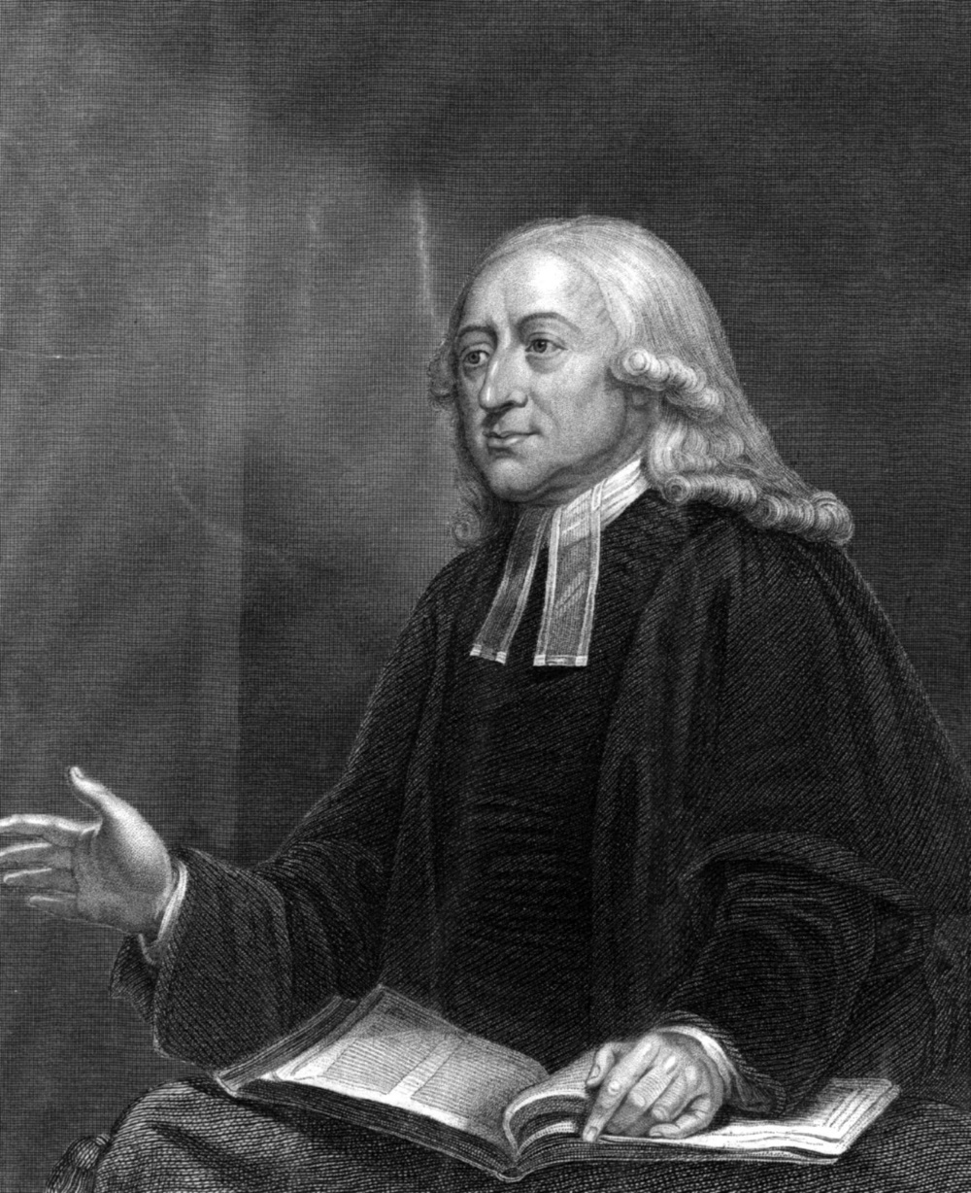
Pray at All Times
[H]is heart is ever lifted up to God, at all times and in all places. In this he is never hindered, much less interrupted, by any person or thing. In retirement or company, in leisure, business, or conversation, his heart is ever with the Lord. Whether he lie down or rise up, God is in all his thoughts; he walks with God continually, having the loving eye of his mind still ﬁxed upon Him, and everywhere “seeing him that is invisible.”
John Wesley Cleric

Slide 8
How to Stand in Prayer (v18)
At All Times
In the Spirit with every prayer and request

Slide 9
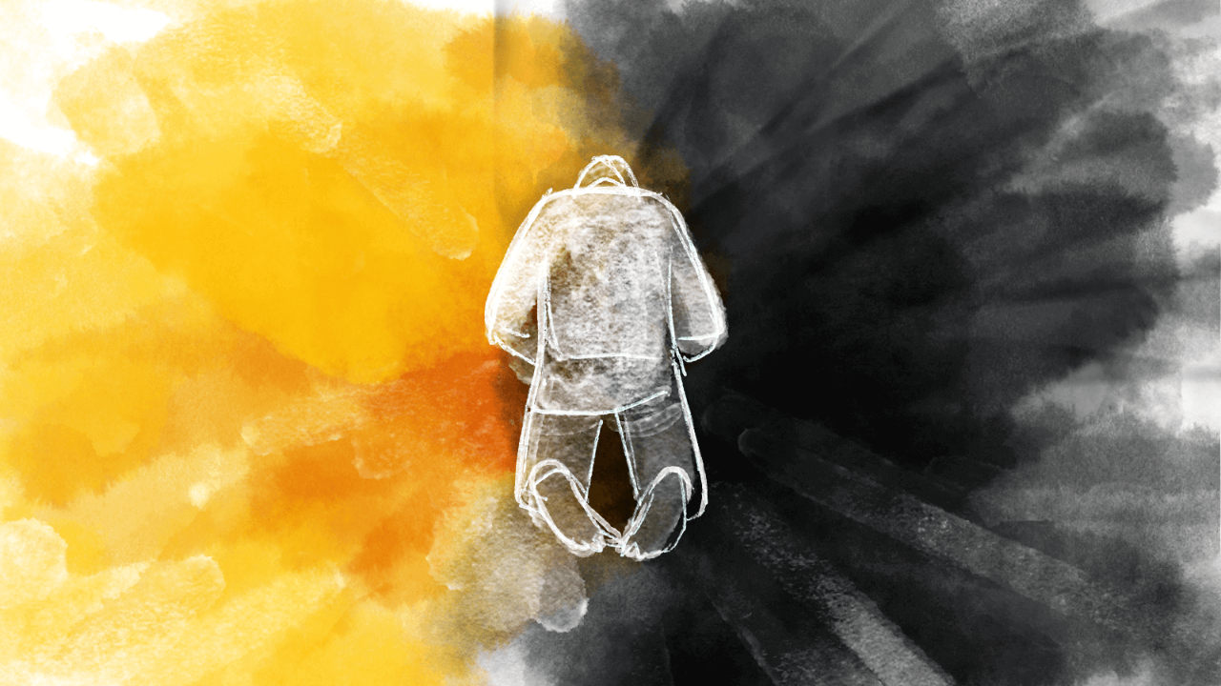
How to Stand in Prayer (v18)
Notes:
In the Spirit with every prayer and request
Note the division between Prayer and requests
Floyd Pierson, a retired Africa Inland Mission worker, was a man who literally prayed “on all occasions with all kinds of prayers and requests.” So habitual was this that in his seventies, when he went to take a driver’s test, he said to the examiner, “I always pray before I drive — Let’s bow our heads together.” The ofﬁcial likely wondered what kind of ride he was in for! I can see him checking his seat belt and settling his hand on the door handle. Pierson passed! But apart from the humor, there is something quite beautiful here — the unaffected witness of a vibrant inner spiritual reality which bubbles up “with all kinds of prayers and requests.”

Slide 10
How to Stand in Prayer (v18)
At All Times
In the Spirit with every prayer and request
Stay Alert

Slide 11
Stay Alert
Notes:
C.S. Lewis – Screwtape Letters
Wormwood: “The best thing, where it is possible, is to keep the patient from the serious intention of praying altogether. When the patient is an adult recently re-converted to the Enemy's party, like your man, this is best done by encouraging him to remember, or to think he remembers, the parrot-like nature of his prayers in childhood. In reaction against that, he may be persuaded to aim at something entirely spontaneous, inward, informal, and un-regularised; and what this will actually mean to a beginner will be an effort to produce in himself a vaguely devotional mood in which real concentration of will and intelligence have no part. One of their poets, Coleridge, has recorded that he did not pray “with moving lips and bended knees” but merely “composed his spirit to love” and indulged “a sense of supplication”. That is exactly the sort of prayer we want; and since it bears a superficial resemblance to the prayer of silence as practised by those who are very far advanced in the Enemy's service, clever and lazy patients can be taken in by it for quite a long time. At the very least, they can be persuaded that the bodily position makes no difference to their prayers; for they constantly forget, what you must always remember, that they are animals and that whatever their bodies do affects their souls. It is funny how mortals always picture us as putting things into their minds: in reality our best work is done by keeping things out.”

Slide 12
How to Stand in Prayer (v18)
At All Times
In the Spirit with every prayer and request
Stay Alert
With all perseverance

Slide 13
With All Perseverance
Luke 18: 2-5
² “There was a judge in a certain town who didn’t fear God or respect people. ³ And a widow in that town kept coming to him, saying, ‘Give me justice against my adversary.’
⁴ “For a while he was unwilling, but later he said to himself, ‘Even though I don’t fear God or respect people, ⁵ yet because this widow keeps pestering me, I will give her justice, so that she doesn’t wear me out by her persistent coming.’”

Slide 14
With All Perseverance
Matthew 7:7
⁷ “Ask, and it will be given to you. Seek, and you will find. Knock, and the door will be opened to you.

Slide 15
How to Stand in Prayer (v18)
At All Times
In the Spirit with every prayer and request
Stay Alert
With all perseverance
With intercession for all saints

Slide 16
With All Perserverance
Matthew 7:7
Ask, and it will be given to you. Seek, and you will find. Knock, and the door will be opened to you.
Notes:
Some years ago the record of a wonderful work of grace in connection with one of the stations of the China Inland Mission attracted a good deal of attention. Both the number and spiritual character of the converts had been far greater than at other stations where the consecration of the missionaries had been just as great. This rich harvest of souls remained a mystery until Hudson Taylor, on a visit to England, discovered the secret. At the close of one of his addresses a gentleman came forward to make his acquaintance. In the conversation which followed, Mr. Taylor was surprised at the accurate knowledge the man possessed concerning this China Inland Mission station. “But how is it,” Mr. Taylor asked, “that you are so conversant with the conditions of that work?” “Oh!” he replied, “the missionary there and I are old college mates; for years we have regularly corresponded; he has sent me names of enquirers and converts, and these I have daily taken to God in prayer.” At last the secret was found — a praying man, praying deﬁnitely, praying daily. (Preaching the Word 41 Vols.)

Slide 17
Don’t you… Forget about me… (v19-20)
¹⁹ Pray also for me, that the message may be given to me when I open my mouth to make known with boldness the mystery of the gospel. ²⁰ For this I am an ambassador in chains. Pray that I might be bold enough to speak about it as I should.

Slide 18
How to Stand in Prayer
Notes:
Dr. John Piper Unless I’m badly mistaken, one of the main reasons so many of God’s children don’t have a signiﬁcant life of prayer is not so much that we don’t want to, but that we don’t plan to. If you want to take a four-week vacation, you don’t just get up one summer morning and say, “Hey, let’s go today!” You won’t have anything ready. You won’t know where to go. Nothing has been planned. But that is how many of us treat prayer. We get up day after day and realize that signiﬁcant times of prayer should be part of our life, but nothing’s ever ready. We don’t know where to go. Nothing has been planned. No time. No place. No procedure. And we all know that the opposite of planning is not a wonderful ﬂow of deep, spontaneous experiences in prayer. The opposite of planning is the rut. If you don’t plan a vacation you will probably stay home and watch TV! The natural unplanned ﬂow of spiritual life sinks to the lowest ebb of vitality. There is a race to be run and a ﬁght to be fought. If you want renewal in your life of prayer you must plan to see it. Therefore, my simple exhortation is this: Let us take time this very day to rethink our priorities and how prayer ﬁts in. Make some new resolve. Try some new venture with God. Set a time. Set a place. Choose a portion of Scripture to guide you. Don’t be tyrannized by the press of busy days. We all need mid-course corrections. Make this a day of turning to prayer — for the glory of God and for the fullness of your joy (Preaching the Word 41 Vols.)

Slide 19
THANK YOU
For joining us!

